Slide 1
Crime Data Analysis
Sangita Lamichhane
MSDS 696_X70_ Data Science Practicum II
Professor John Koenig
2022

Slide 2
Project Overview
The year of 2020 had a historic rise of demonstrations across the United States calling to 'Defund the Police.' The funding trend of increasing police spending was reversed for the first time in years by reducing the Los Angeles Police Department (LAPD) budget by $150 million.
This project will analyze the available crime data with simple exploratory data analysis and using Machine learning to predict the crimes that can occur in Los Angeles.

Slide 3
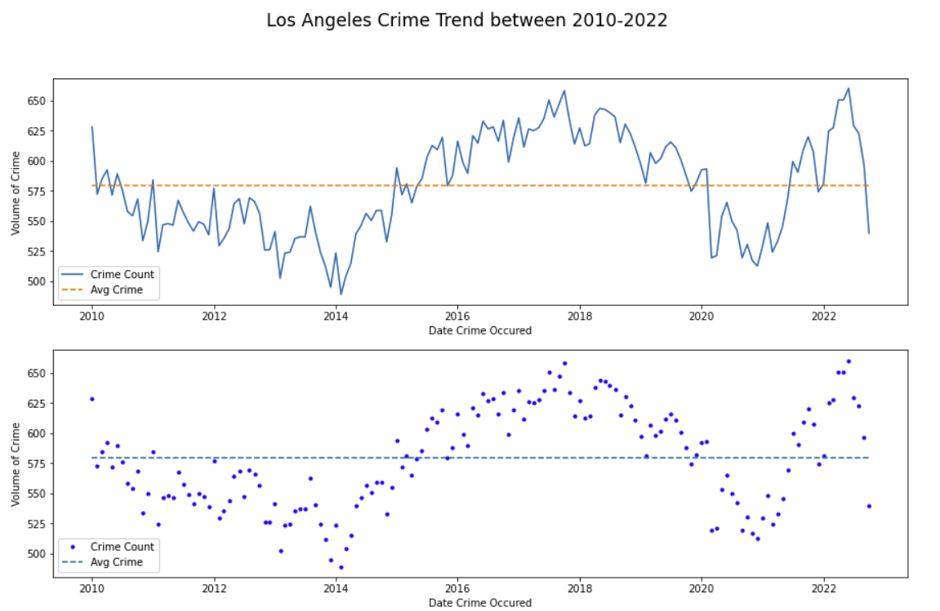
Research Problem
Los Angeles police department is one of the largest in the country, with jurisdiction of around 4 million people. Through this project analysis we aim to do time series analysis and exploratory data analysis to This project studies the following business problem from the data:
Areas in LA with highest reported crime.
Top impacted demographics in LA.
Crime trend during the time period of study.

Slide 4


Research Process
Gather Data
Clean Data
Data Exploration and Visualizations
Model Iterations
Model Evaluation
Analysis

Slide 5
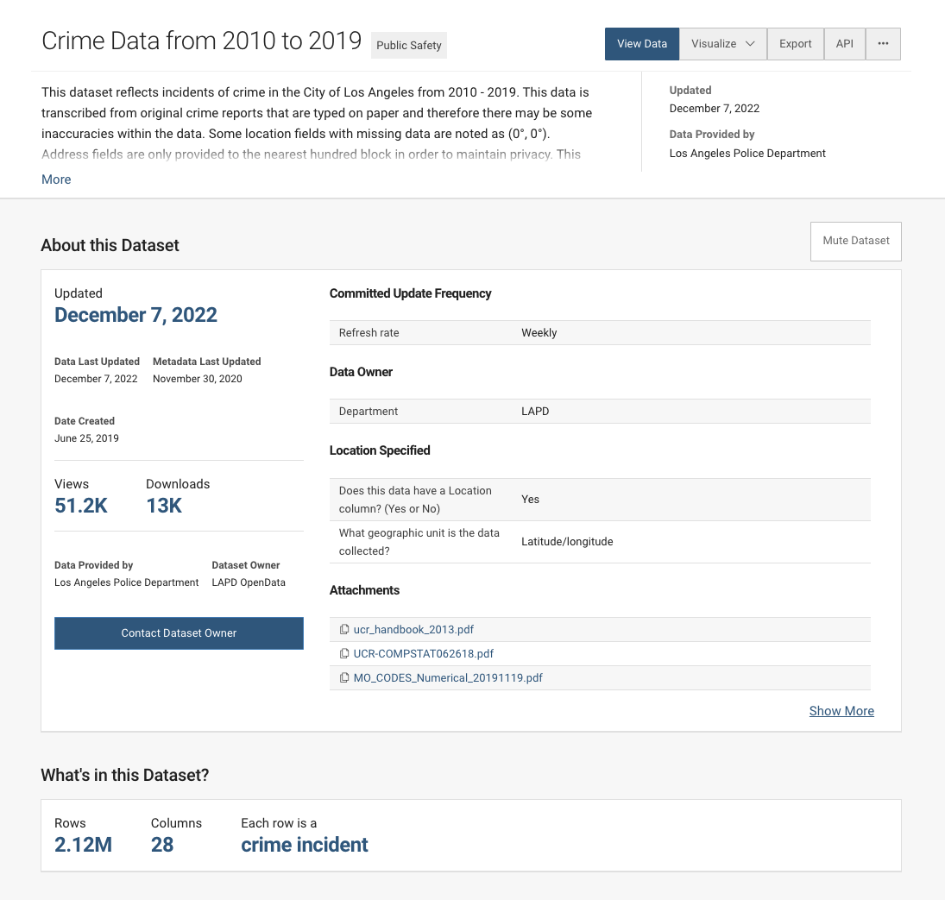
Data Description and Understanding
The data is Los Angles Crime data for this project taken from the city of Los Angeles website.
The data reflects incidents of crimes in the City of Los Angeles
The datasets consists of crime data from 2010 to 2019 and 2020 to 2022.
The datasets consists of 2,714,774 observations over 28 variables.
Each row provides a record of information on crime that was reported, location it occurred, time it occurred, crime type, and information on the victims of the crime.

Slide 6
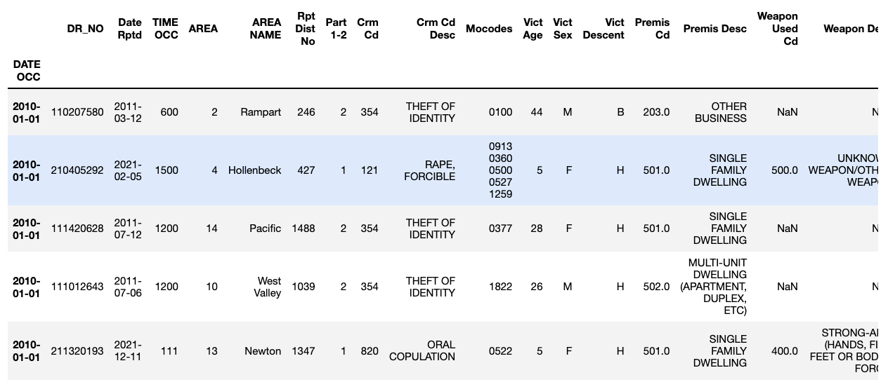
Methodology
Exploratory Data Analysis
Data loading and data preparation
Preliminary Data Analysis
Loading two different dataset
Data Cleaning
Removing all NANs
Converting date to time series Index
Dropping columns irrelevant to the modeling
Saving cleaned dataset from analysis
Visualizations

Slide 7
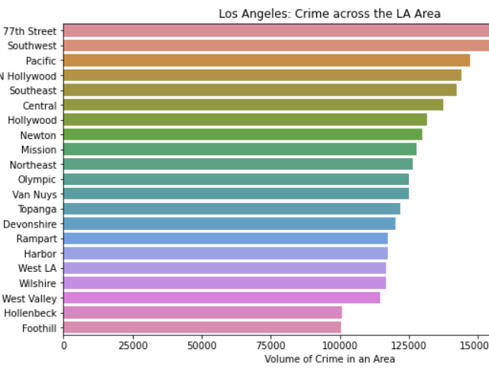
Areas in LA with highest reported crime
The highest crime areas are 77th Street, Southwest, and Pacific.

Slide 8
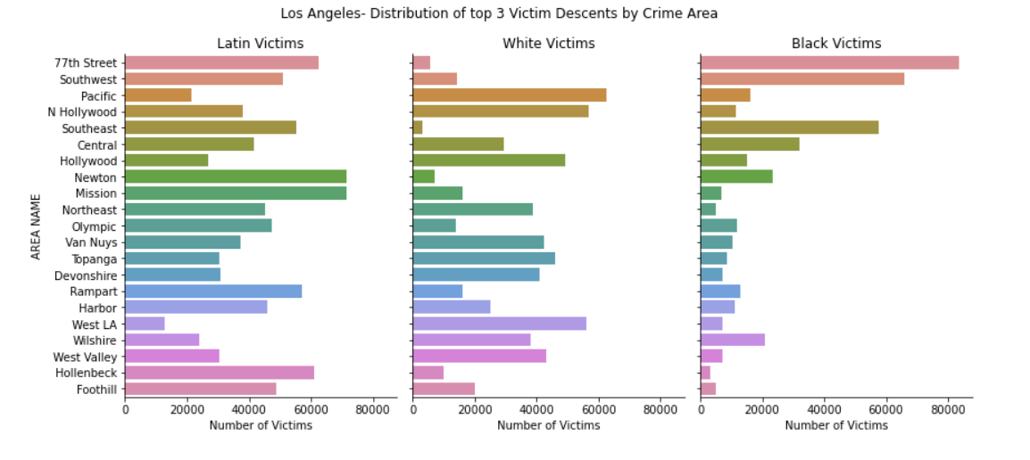
Top impacted demographics in LA.
The top vulnerable communities in LA is Latina and Black communities.

Slide 9
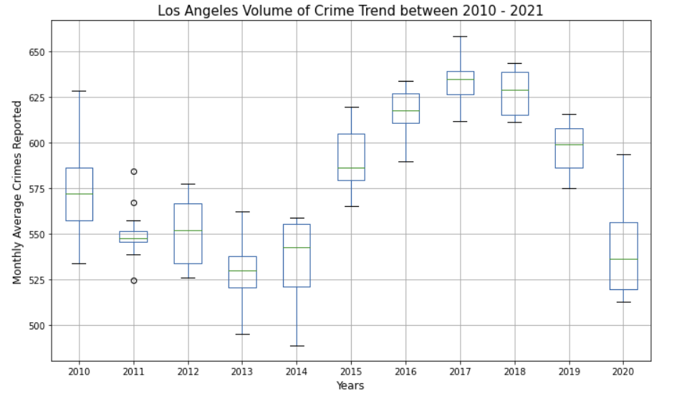
Crime Trend during the time period of study.
2013
While year 2013 saw the lowest average number of crimes reported in LA.
2017
Year 2017 saw the highest average number of crimes reported, while 2013 saw the lowest average number of crimes reported in LA.
2017–2020
Also, we can see decreasing trend of average crime from 2017 to 2020.

Slide 10
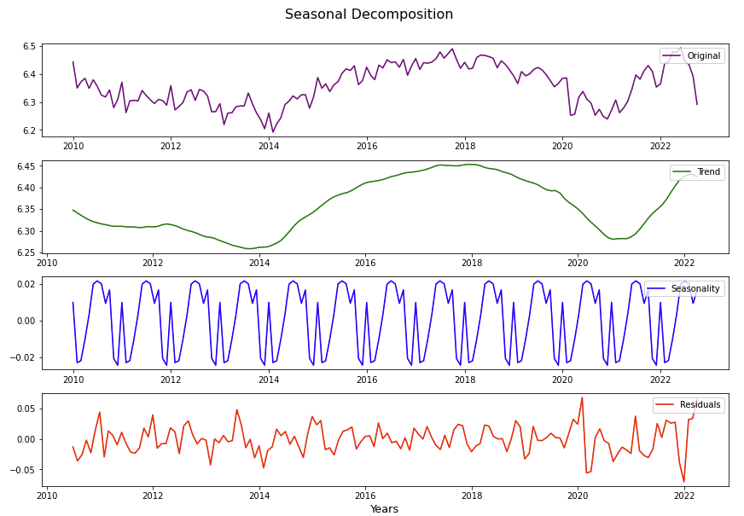
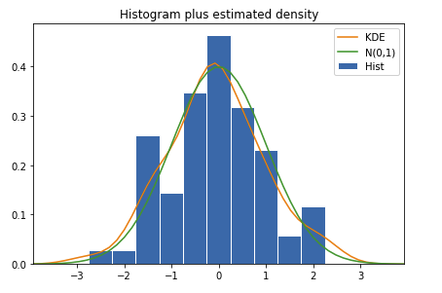
Methodology
Time series modelling for prediction
Models for forecasting a time series that can be stationarized through differencing.
Decomposition
Forecasting
Forecast future events based on historic data, based on autoregressive moving average (ARMA) or autoregressive integrated moving average (ARIMA) mode
Decompose time series into long term trends, seasonal variation, repeated but non-periodic (cyclic) fluctuations, and residuals (irregular components)

Slide 11
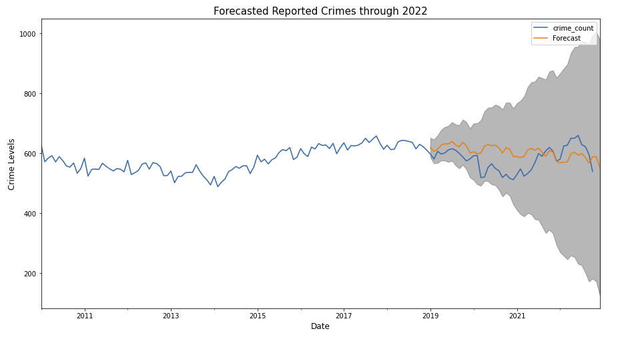
Model Performance
Model | AIC
AR-1 | 951.28
MA-1 | 1038.10
AR-1-diff | 937.06
MA-1-diff | 941.61
ARMA-3,0,5-diff | 900.13
SARIMA | 722.89
Analyzed the time series data for stationarity as well as stationarity in the residuals of the time series.
We also identified trend and seasonality in the data by performing a seasonal decomposition of the time series.
Model iterations included AR, ARMA and SARIMA algorithms. We compared the models against each other using the AIC score.

Slide 12
Future Considerations
Include
Include Exogenous variables
Perform
Perform advanced models such as Facebook prophet for comparison and validation
Gather
Gather additional historical data for strong future analysis

Slide 13


Thank you!

